Slide 1
quantum roots of alternate reality narratives in games
PAX-West Sep. 2016
brian kirkby
bkirkby@kirkby.org
http://bkirkby.github.io/ @therealpheirce
Notes:
Welcome to “quantum roots of alternate reality narratives in games”, my name is brian kirkby and what i have for you today in my presentation is i’m going to tell you a little about myself and how i ended up here at PAX, then i’m going to teach you everything you need to know about quantum mechanics in about 25 minutes, then lastly i’m going to show you how quantum mechanics leads to the idea of alternate realities. Hopefully we’ll have some time after for q&a.

Slide 2
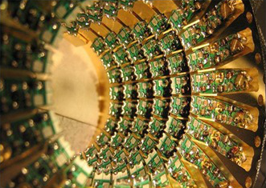
Notes:
I’m not a quantum scientist. I am a software engineer. I came to the world of quantum physics through the route of quantum computing. As professional interest, i would read articles about quantum computing and i was curious as to where we are with the state of quantum computing and what things could it do for us. I quickly learned that in order for me to understand what was happening with quantum computers, i needed to understand the underlying mechanics a lot better than i did, so i embarked on a months, even years long journey to learn quantum mechanics well enough. What i leanred blew my mind and i wanted to blow the minds of other people with the science. I became obsessed with explaining the theories to anyone that i could get to sit still for long enough. It became something of an issue when i found out my high school aged daughter would tell her friends “if you come over to my house, there’s a toll to pay. When my dad meets you, he’s going to teach you quantum mechanics. That’s the toll.” and i did that with high school kids because what i had learned was that the science was not really that complicated and i knew the material could be condensed into a much more consumable format. After i had figure out how to condense quantum mechanics down, i then tacked on some material about the state of quantum computing and gave a quantum computing presentation to a few different places. So that’s how i came to speak on quantum mechanics.

Slide 3
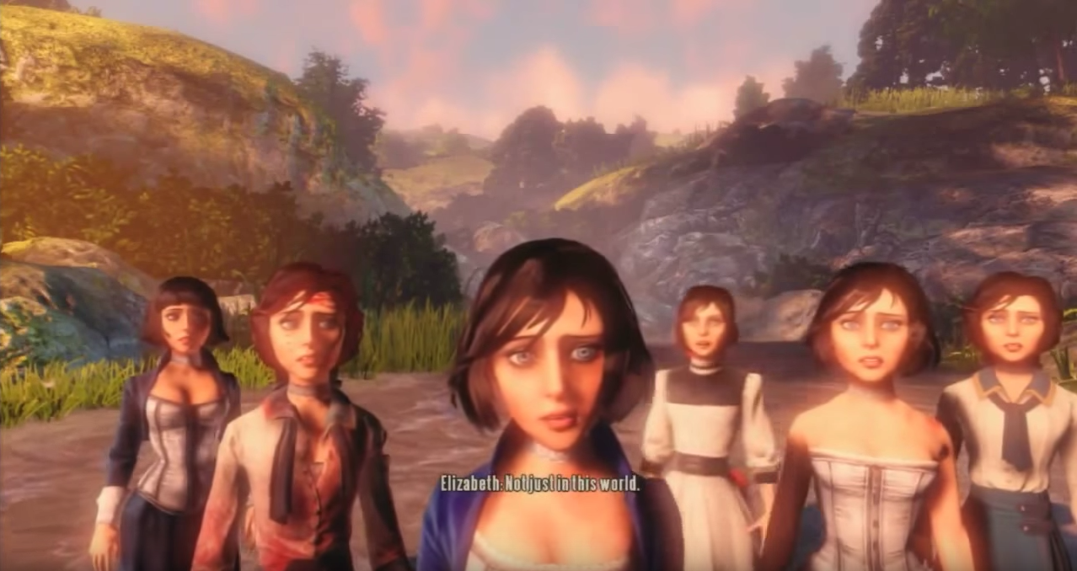
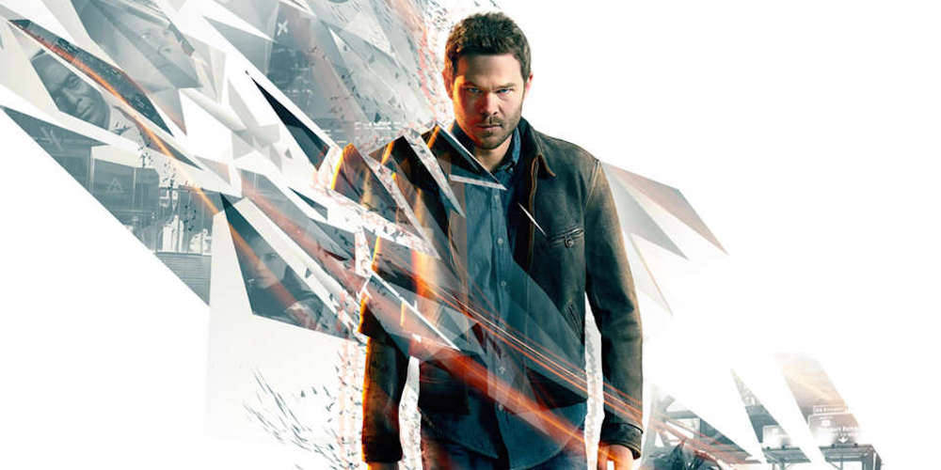
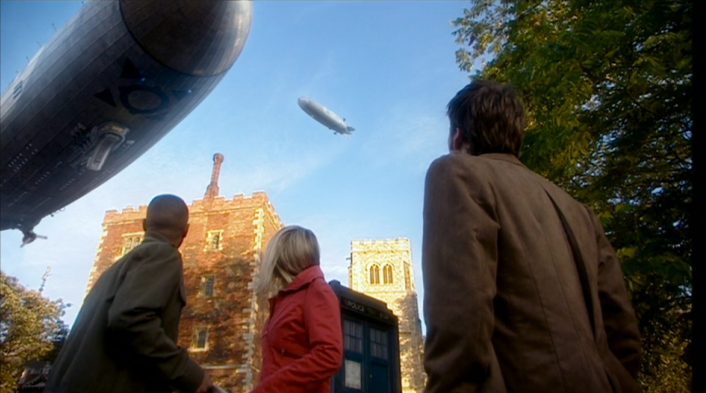

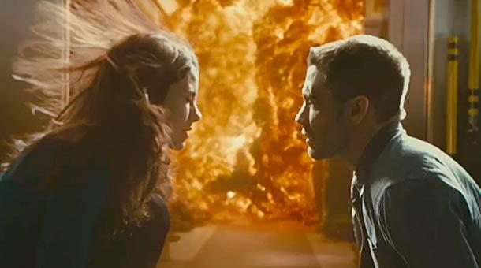
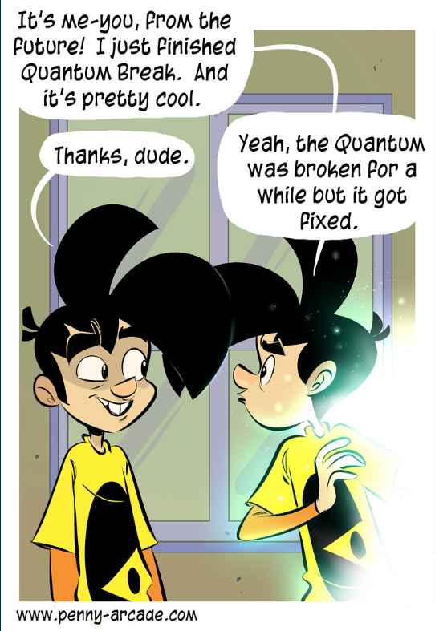
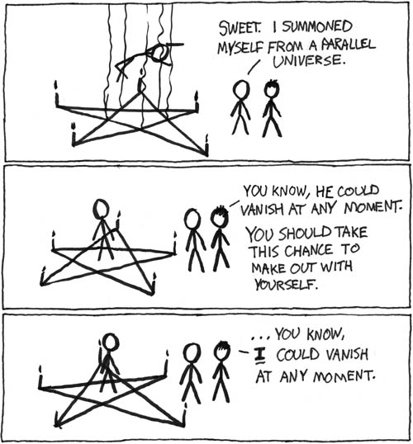
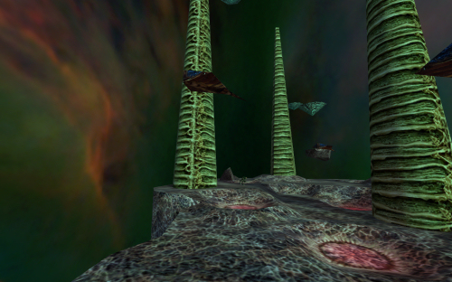
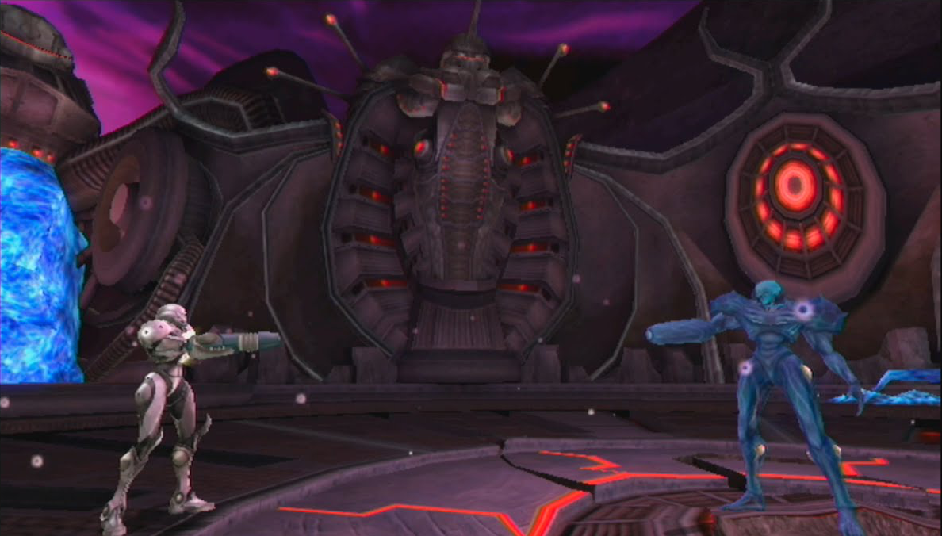
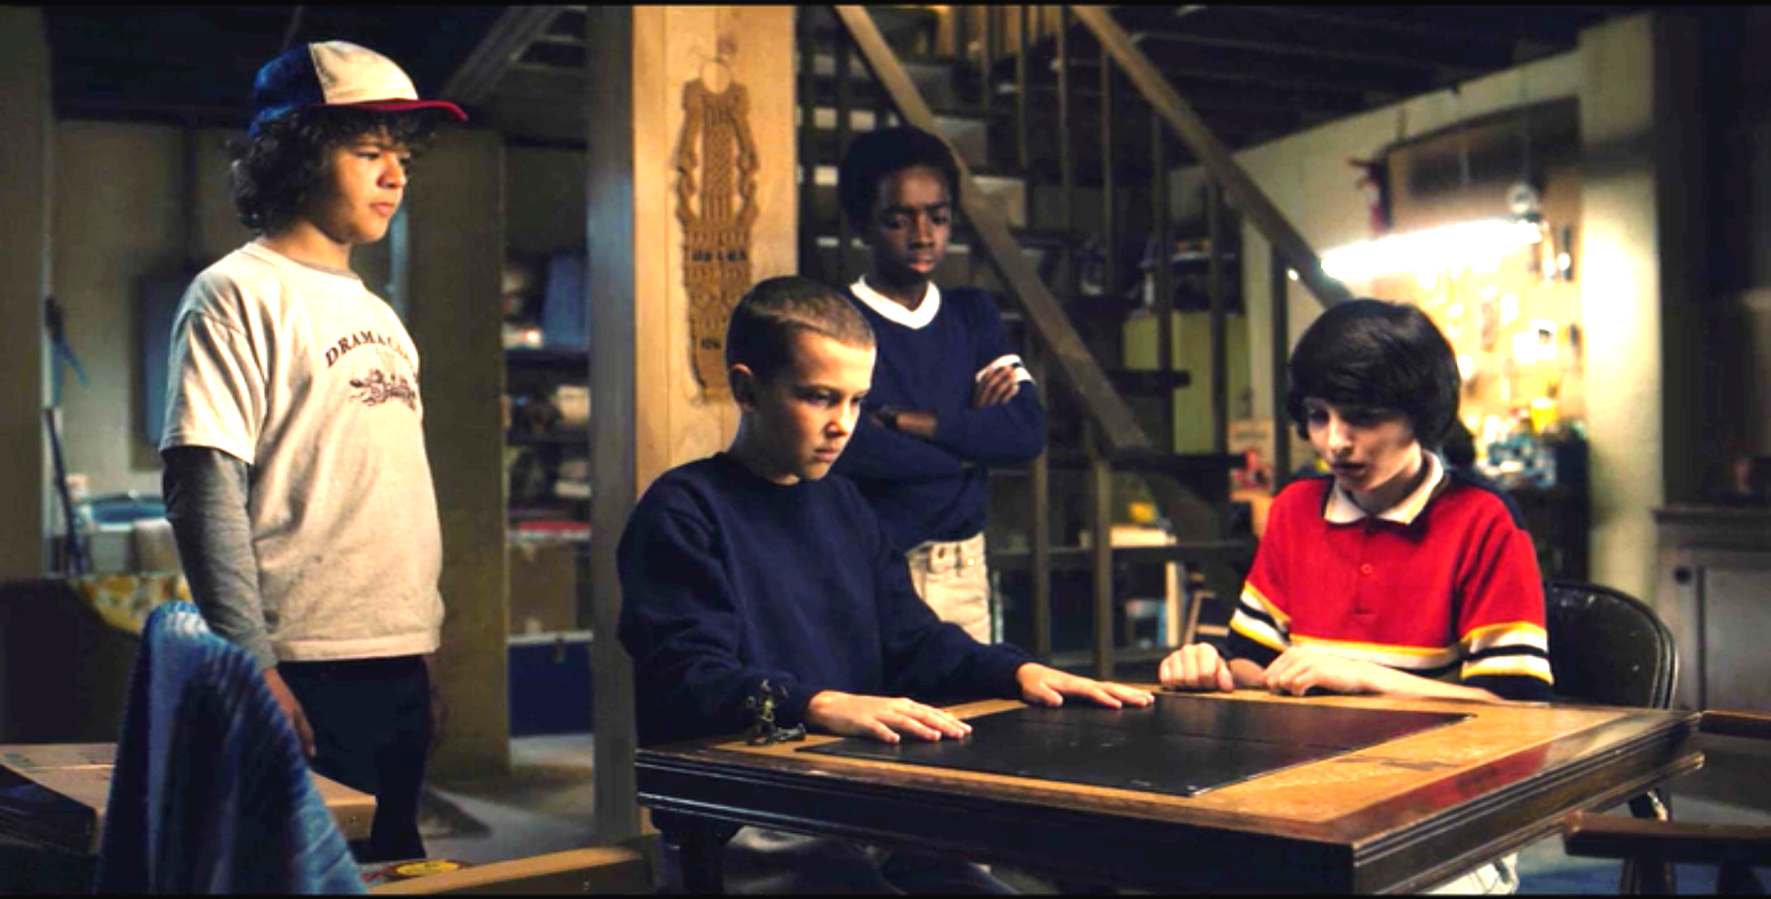
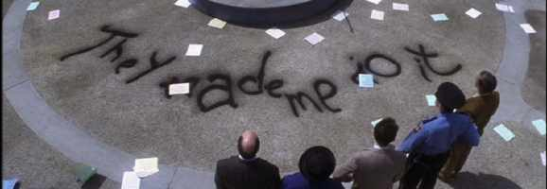
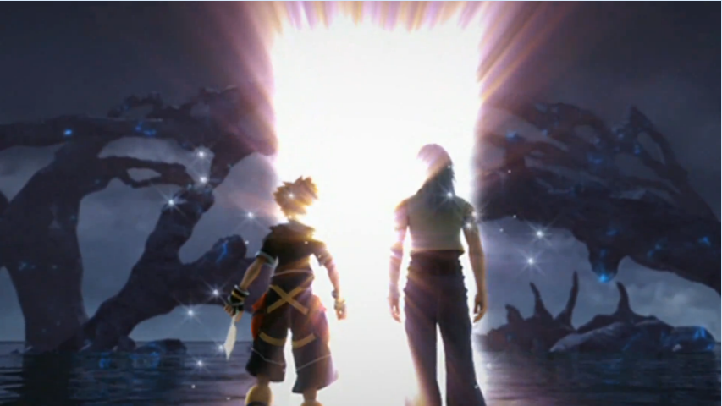
Notes:
How i ended up at PAX is that in january at PAX south i was speaking with someone who was telling me about a game that employed alternate realities. I don’t really remember which game it was, probably chrono cross, but i remember thinking “i wonder how many people are aware that alternate realities have roots in real quantum science?”, then i thought “i wonder if a PAX audience would be interested in a presentation about it?” so i modified my quantum computing talk, submitted it to PAX and here i am. The use of parallel universe is quite the common trope in the games we play. As i thought about it, i realized that it’s not just our game narratives, but it’s also out TV shows, our movies, and yes, even our web comics. Clearly the idea of alternate universes is rich ground for the stories we want to tell in whatever medium we tell stories.

Slide 4
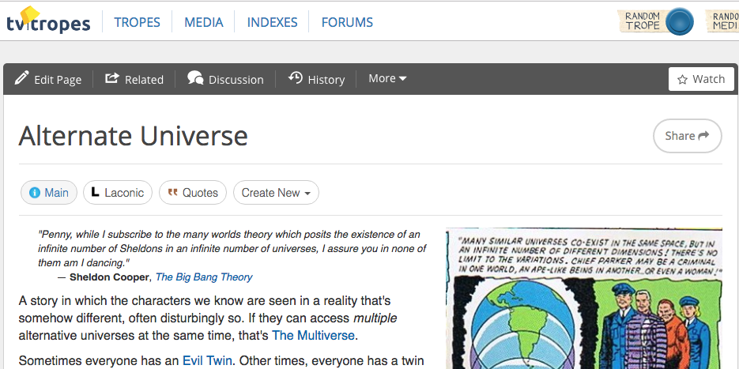
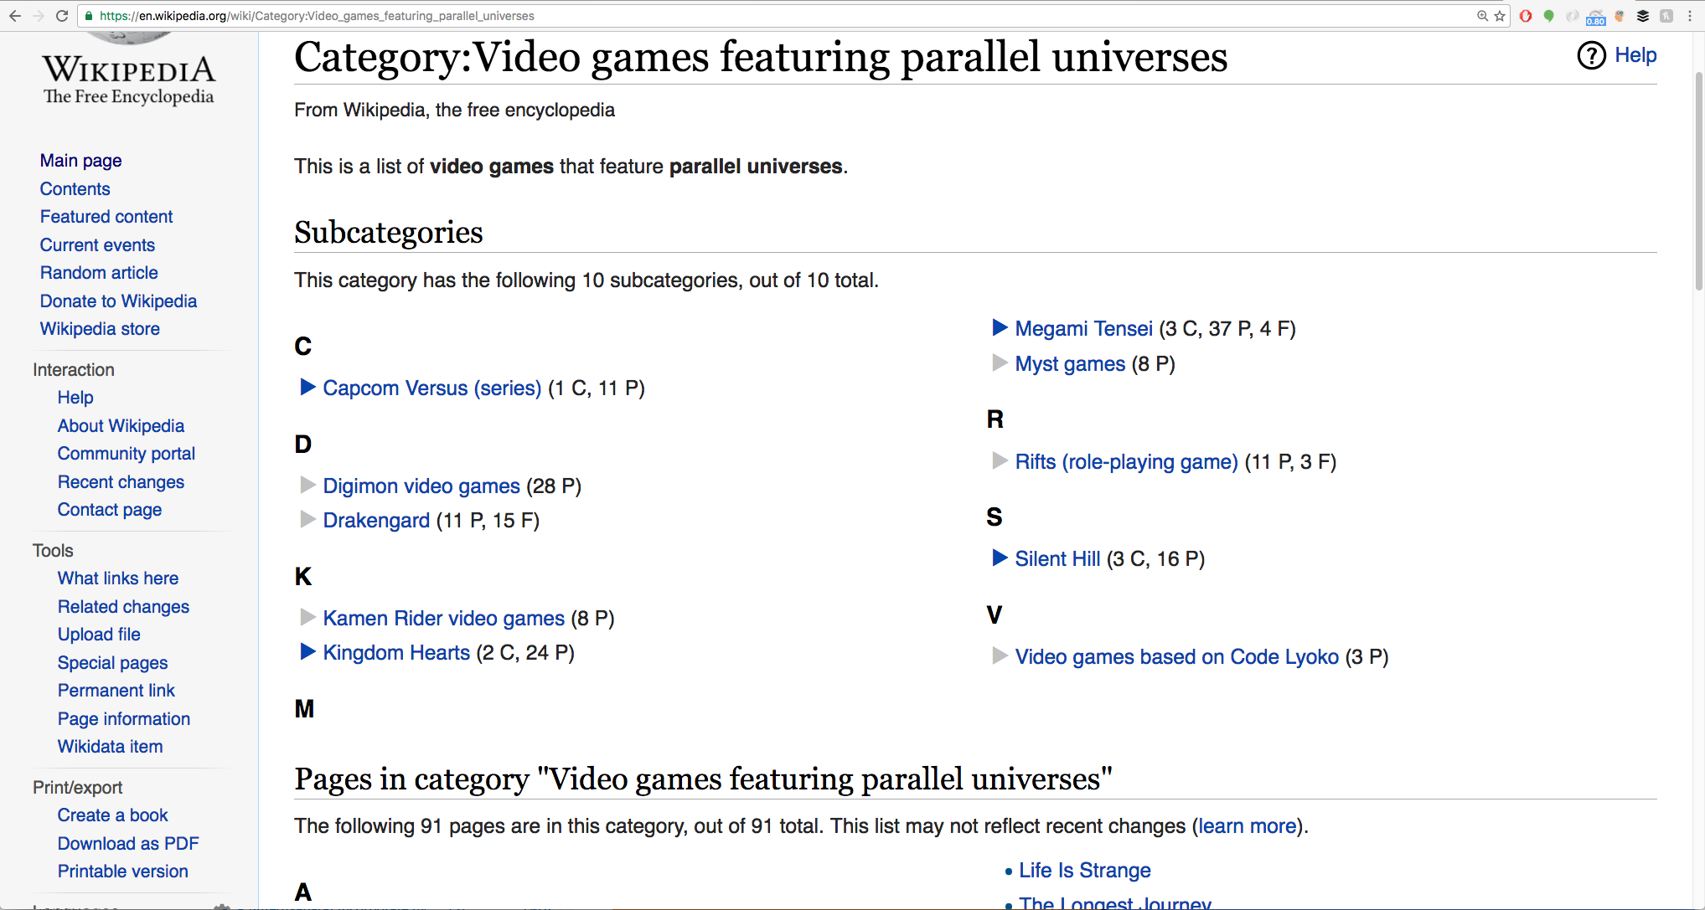
Notes:
I found it that the idea is such a common trope, that there are even wiki pages dedicated to cataloguing the use of alternate realities in our fiction. And to make it clear, the idea of parallel universes and alternate realities are the same thing.

Slide 5
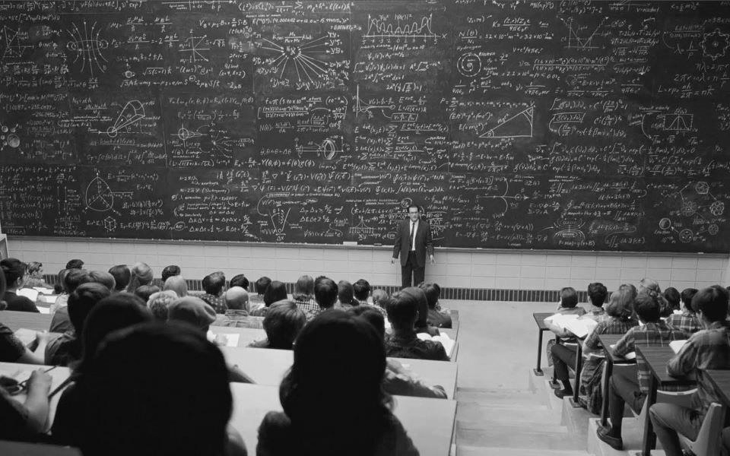
?
?
?
?
?
?
?
?
?
?
?
?
?
?
?
?
?
?
?
?
?
?
?
?
?
?
?
?
?
?
?
?
https://www.flickr.com/photos/irisheyes/8073895368/
Notes:
Now when i tell people that i’m going to teach them everything they need to know about quantum mechanics in 20 minutes, most people scoff at the idea. They think that the subject is simply not accessible to them. i think there are two main reasons why people think that, so i want to put those to rest for us here today. The first reason is that the subject matter seems so daunting. It’s the smartest people in the world working with very involved mathematics who work on this stuff, so clearly it’s not for us. While those things are true, when i say i’m going to teach you everything YOU need to know about quantum mechanics, i’m saying that YOU don’t need to know the mathematics involved or spend years of study. For our purposes, it really is a 20 minute lesson and you will be able to understand. The second reason that i think people find the material inaccessible, is because if they have ever endeavored to learn about quantum mechanics, they inevitably get to a point where they realize they do not understand what is going on. They think their confusion is because they are just incapable of understanding the material, but i want to tell you, it’s not your fault when you reach that confusion point. It’s the fault of the material because EVERYONE is confused about what is going on. And that includes the people who developed the theory as well as the people who are working on the theory today. Quantum mechanics has simply revealed something very strange and unexplained about our universe. My goal with this presentation is to get you to the point wher you understand what IS understandable, and then you just identify and acknowledge what is just strange. And when i say EVERYONE is confused by what is happening in quantum mechanics, let me give you some examples:

Slide 6
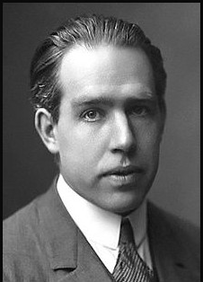
if quantum mechanics hasn’t profoundly shocked you, you haven’t understood it yet
Niels Bohr
Notes:
This is what neils bohr had to say about it. He was the main pioneer of quantum mechanics and the main interpretation of the strangeness of quantum mechanics is named the “copenhagen interpretation” after where he lived and practiced physics. So he expects that the theory will profoundly shock you.

Slide 7
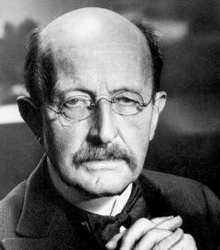
science cannot solve the ultimate mystery of nature. and that is because, in the last analysis, we ourselves are a part of the mystery that we are trying to solve
Max Planck
Notes:
This is max planck. He’s another pioneer of quantum mechanics. He’s the guy who did the math that first identified the quantum, although he thought it was just a strange mathematical anomaly. It might be a bit esoteric here about what he’s talking about when he says that we can’t understand the mystery of nature because we are a part of it, and i will explain that later and come back to this quote. But you have to admit that it’s pretty bizarre for a scientist to say that science can’t solve the mystery of nature. That’s what science was created for, but when i come back to it, you will completely understand why he’s so fatalistic in his assessment here and you might even agree with him.

Slide 8
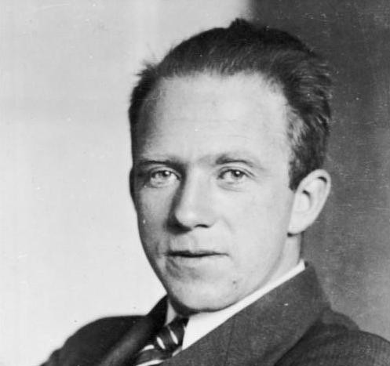
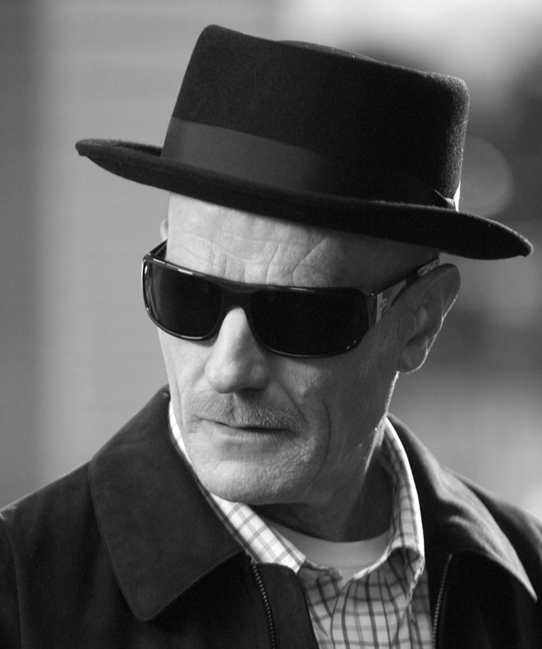
not only is the universe stranger than we think, it is stranger than we can think
Werner Heisenberg
Notes:
This here is werner heisenberg. He’s another pioneer of quantum mechanics who is well known for the “heisenberg uncertainty principle”. Today he might be more well known as the namesake of one walter white’s alter-ego. And here is what he has to say about how strange quantum mechanics is.

Slide 9
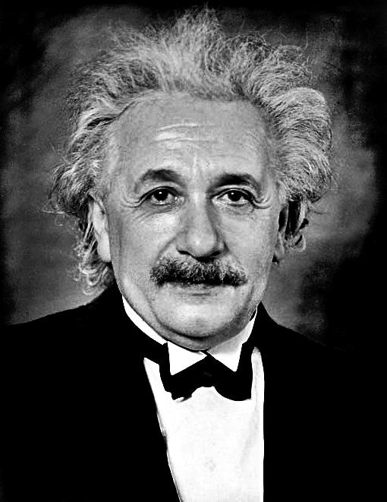
as i have said so many times, God does not play dice with the world
Albert Einstein
( “stop telling God what to do” -- Niels Bohr )
Notes:
This guy, you guys all know. Einstein was the grandfather of quantum mechanics because he discovered the quantum itself. He took planck’s mathematical anomaly and made it real. It might be a bit unclear here about what he’s talking about, but to give you a little background. While einstein was the grandfather of quantum mechanics, he didn’t actually work much in it. Other scientists picked up the strangeness that einstein revealed and they developed the mechanics to a remarkable degree. And while einstein agreed with the mechanics and all it taught us about the world, he never could get on board with bohrs interpretation (which i’ll get to later). In fact, he and bohr had a rivavlry that lasted the rest of einsteins life. He kept trying to come up with thought experiment after thought experiment to disprove bohrs interpretation and bohr kept coming up the victor. One of the things that einstein had a problem with about bohrs interpretation, was the fact that at the fundamental level, things are not deterministic. Instead they just rely on probabilities. Einstein, knowing the value of a good sound bite, would say that “God does not play dice with the world”, to which neils bohr would always respond “stop telling God what to do”.

Slide 10
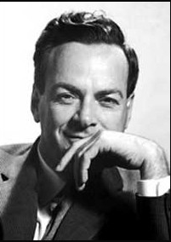
i think i can safely say that nobody understands quantum mechanics
Richard Feynman
Notes:
This here is richard feynman. He is a nobel prize winning physicist who won his nobel prize for Quantum Electro-Dynamics. So he’s a quantum scientist who is saying there that noone understand quantum mechanics.

Slide 11
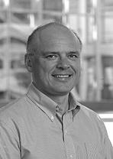
a good [mental] fight with [quantum mechanic] propositions is probably psychologically necessary if you are ever to get on top of the subject
David A. B. Miller
Notes:
And finally, there’s this guy. Dave A. B. Miller. He’s a professor at Stanford who teaches an online course called “Quantum Mechanics for Engineers and Scientists.” it’s a MOOC and is freely available via Stanford Online. I do recommend anyone who is intersted to take it. We live in an amazing time. Here is what Professor Miller has to say in his introductory video to his course. He’s saying that it’s psychologically necessary for you to struggle with that strangeness and ambiguity in quantum mechanics before you can really understand. So you are going to struggle a bit, and that’s fine, because everyone does it. Ok, now for everything you need to know about quantum mechanics in the next 25 minutes. And how i’m going to do that, is i’m going to go through a history of scientific discovery of one question. And that question is “what is light?”

Slide 12


what is light?
or
Notes:
Early on people anted to know if light was a wave or a particle. We knew about naturally occurring phenomena that were waves. For example, sound is a wave. When you pluck a guitar string, it creates a vibration in the air that creates a wave traveling to our ears. And depending on the properties of the waves, we will hear that sound differently. Different wavelenghts, frequencies, periods, etc. will produce a different sound to our ears. So there are some phenomena in the world that is ust simply waves. On the left side though, we have light as a particle. We reasoned that all the stuff around us is made of just smaller stuff. And you can break the stuff down to smaller and smaller parts until you get to the very small parts that you can’t see, but that still make up everything. And so the early question was “is light a wave or is it a particle?”

Slide 13
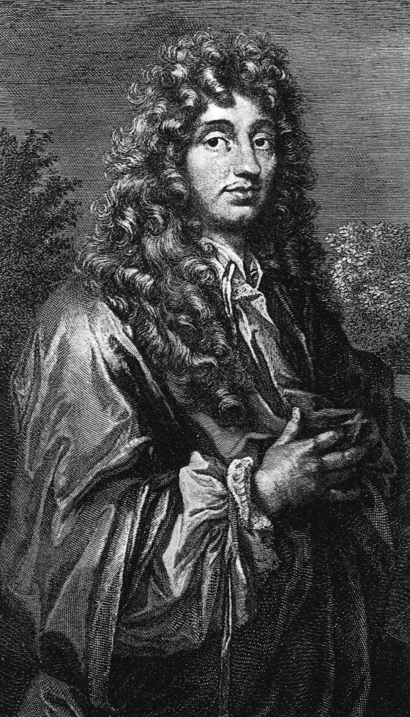
1678
Notes:
Then in the late 17th century, this guy came along, his name is christian huygens. He was a scientist who did a lot of experimentation on light and he came to the conclusion that light is a wave. And i won’t go over all the reasons why he thought this, but let me explain just one.

Slide 14
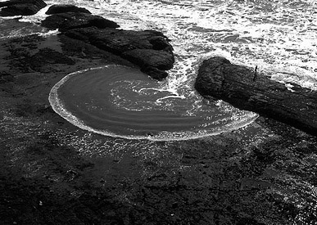
Notes:
Waves have a property called “difraction” which is a fancy word for describing something that you all probably intuitively know. Let me explain. If you have a wave traveling and that wave hits a wall, and that wall has a hole, the wave doesn’t continnue beyond that wall in a stright line the width of the hole. Instead, the wave will spread out beyond the hole and fill up the space behind it as you can see happening in this picture. That spreading out around corners is called “difraction”

Slide 15
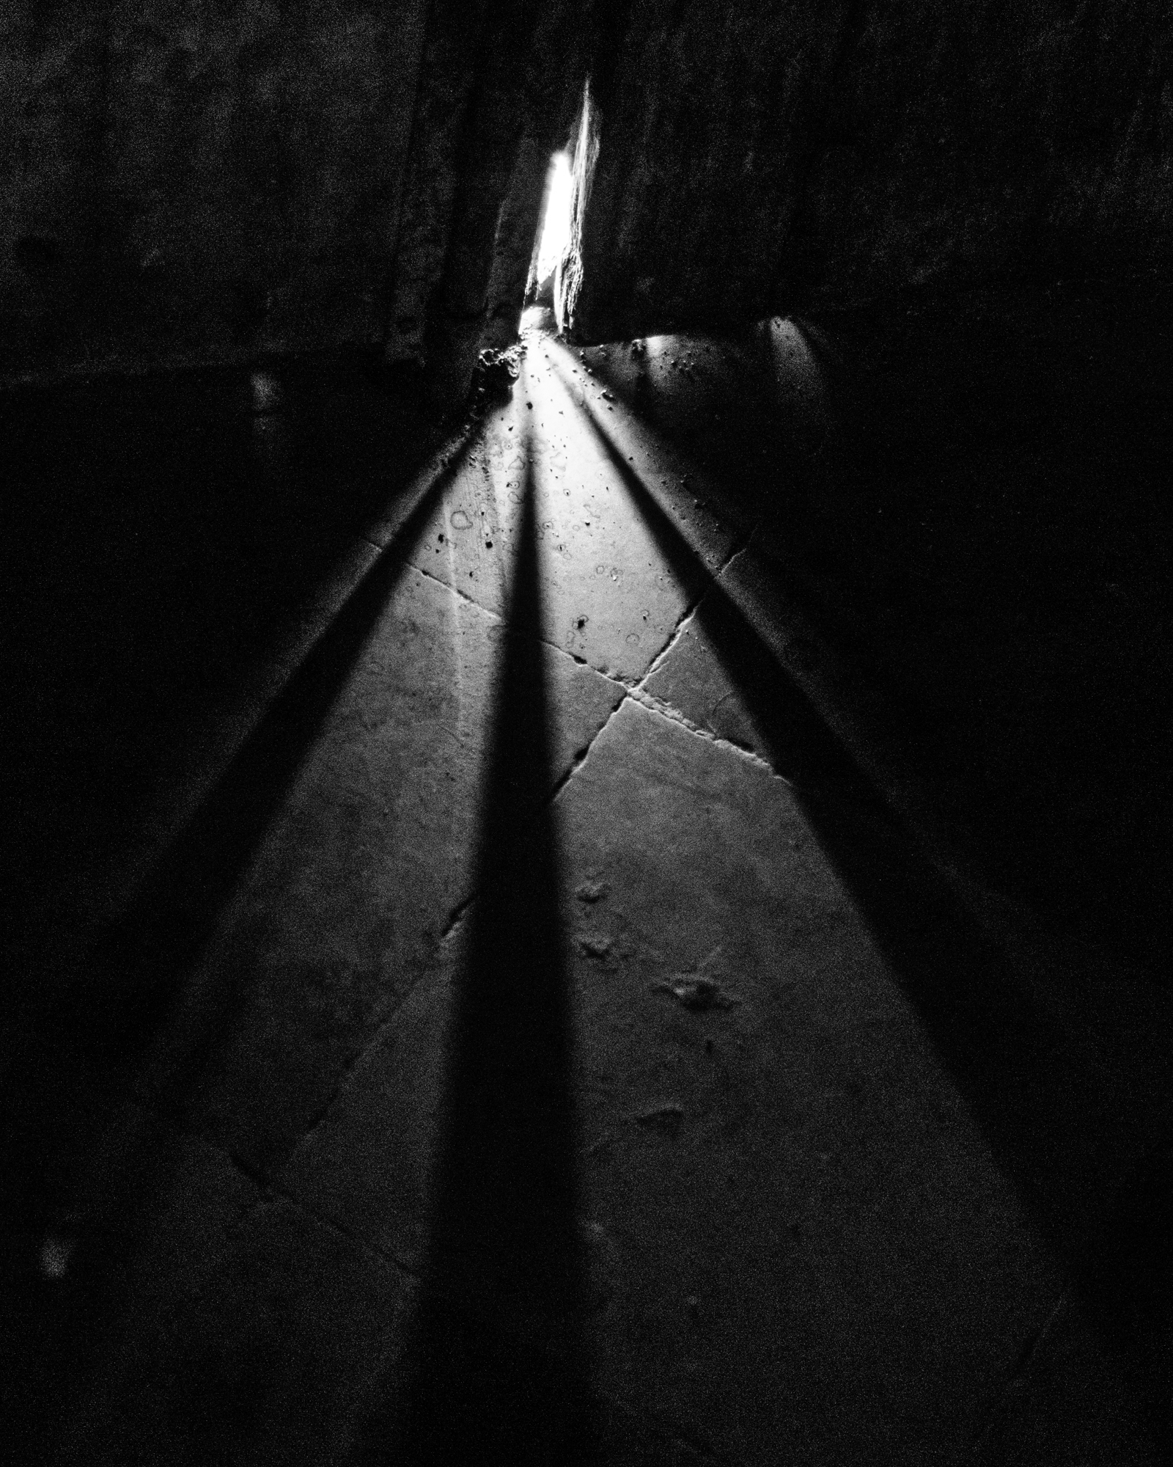
https://www.flickr.com/photos/almostinfamous/27667692301
Notes:
Huygens noticed that if you had a wall that was light on one side and dark on the other, when you punched a hole in that wall, the light would enter the dark side and kind of spread out like a wave. As you can see here, it’s srpeading out in a cone pattern. Huygens said “this looks a lot like diffraction to me, so imma say that light is a wave”

Slide 16
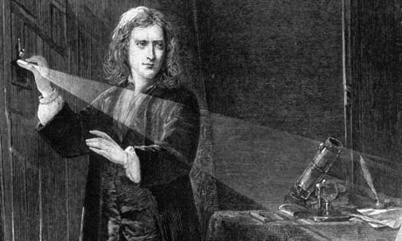
1672 / 1704
Notes:
But huygens had a contemporary by the name of sir isaac newton. Newton also had done a lot of experimentation on light, in fact he literally wrote the book on light. And newton had come to a different conclusion than huygens. He said that light was a particle. And, again, i won’t go into all the reasons he said this, but let me share with you just one.

Slide 17

Notes:
What you see happening here is an example of “refraction.” again, you don’t really need to know the word, but it’s just a word that explains something that you probably intuitively know. But let’s follow this straw on this glass starting at the bottom. As we go up the straw, when we hit the top of the water, it looks like the straw has jumped to the left to continue on up to the top. Now, we all have expereince with the visual distortion that water does. We know that the water is not mangling the straw nor are there two straws there, but clearly there is something happenig here with light that makes us see it differently. And what is happening is that the light is being bent by the water. That bending is called “refraction.” newton noticed this phenomena and in his numerous experiments, he was able to calculate the angles of bending that water would produce for an observer. Those angles were predictable and were sharp like what would happen with a ricocheting bullet. Newton then reasoned that waves don’t behave like this. The only way to produce such sharp angles would be if the light showing us the objects was actually a particle.
He came up with a pre-atomic theory of particles that he called corpuscles and declared that light was particle. And newton pretty much won the day because of who he was. If issaac newton tells you something about the nature of the universe, you’d be wise to listen to him, and so everyone did. And for 100 years people thought that light was a particle because newton said so.

Slide 18
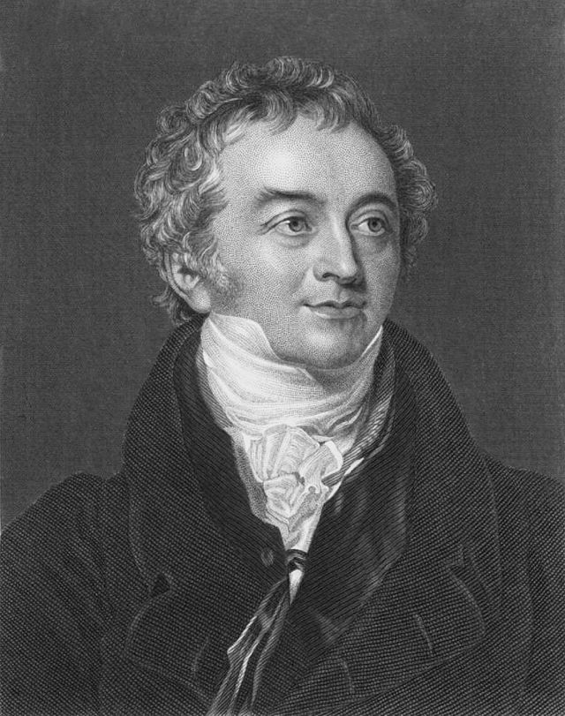
1803
Notes:
But then 100 years later this guy came along. His name is thomas young. And young was a scientist who through that huygens had some good points about light. He wasn’t completely convinced by newtons reasoning. He thought light may be wave, but he said that we know enough about the properties of waves, that we should be able to come up with an experiment to definitely prove whether or not light was a wave.

Slide 19
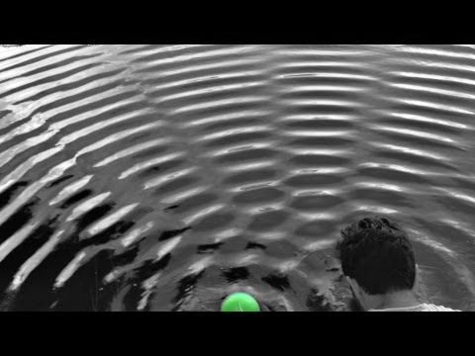
Veritasium : https://www.youtube.com/watch?v=Iuv6hY6zsd0
Notes:
And specifically, he was thinking about how waves behave when they are close to each other. You can’t see in this picture, but on the other side of this guys head is another green ball that he’s bouncing on the water to produce waves. So he’s creating two different wave sources and you can see how those waves blend and interfere with each other as the srepad out. Young knew this about waves too and in particular, he noticed the spots on the water where the peak of one wave and the trough of the other wave are meeting together to cancel each other out.

Slide 20
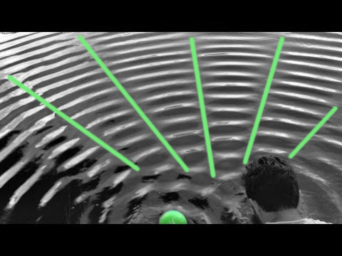
Veritasium : https://www.youtube.com/watch?v=Iuv6hY6zsd0
Notes:
And you can see those here on these green lines. Those smooth spots on the water are where the peak of one wave and trough of the other wave are interfering destructively.

Slide 21
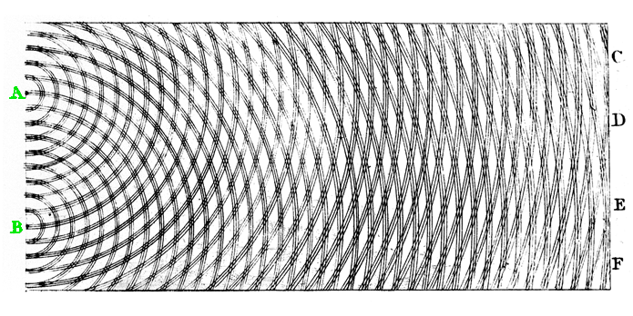
Notes:
So young drew this diagram. And he reasoned that if light was a wave, then we could create a light source at A and B, and the waves would then srpead out and interfere with each other. And, specifically, would interfere destructively with each other. Now, you couldn’t see the waves traveling through the air like you see the waves traveling through the water, but young reasoned you didn’t need to because the interference would continue all the way through until it hits the back screen. He labeled the interference spots at C,D,E,and F, and reasoned that, if light were wave, you should not see light at those spots, but in between them, you would see light. If light was a wave, then you’d see a striped pattern. But if light were particles, then you should just see a blotch of light behind A and another blotch of light behind B. So young decided to do this experiment.

Slide 22
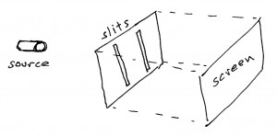
Notes:
He built a boox that had a single light source and then a wall with two slits in it. And that’s the name of this very famous experiment “young’s double-slit experiment.” the idea is that when the light hits those slits, then, if light’s a wave, it would diffract at those slits creating two different wave sources. Those wave sources would then spread out, interfere with each other, and then we’d just have to look at the back screen to see if it were a wave pattern or particle pattern. So he built the box, turned the light on, and this is what he saw:

Slide 23
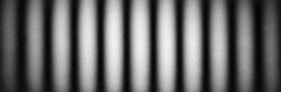
interference
Notes:
He proved, beyond doubt, that light is a wave. He overturned newton. There were other experiments as well that also show that light is a wave, but this is the iconic one. So, absolutely, light is a wave. But, that’s not the end of the story, as you may have guessed.

Slide 24
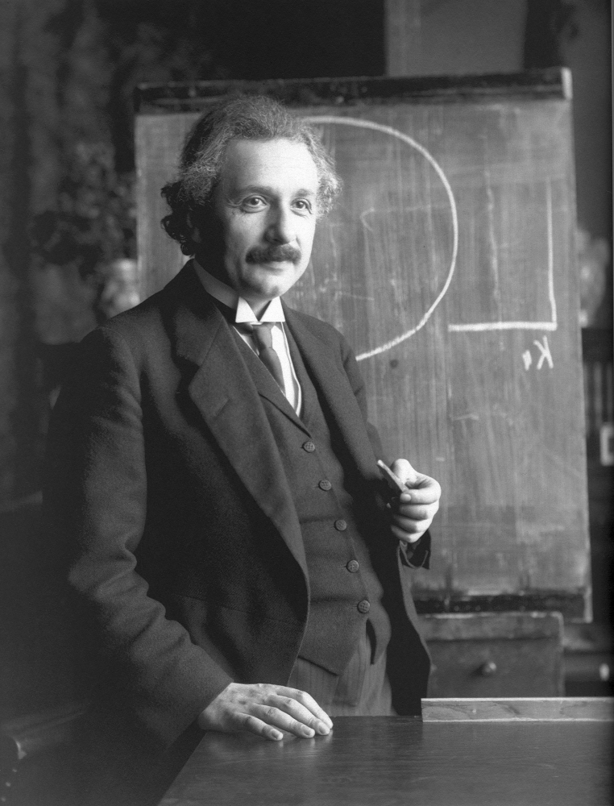
1905
Notes:
Because 100 years later, this guy came along. Albert einstein. In 1905 einstein wrote 5 very remarkable papers. He’s most well known for one paper that was the “theory of relativity.” he next well known for another paper that created the equation “E=mc^2”. What he is not as well known for was his paper that talked about the particle nature of light. One thing that’s remarkable about these papers is that einstein did not view his paper on relativity to be as revolutionary as we all do. He thought his work there was just a natural progression of the work that had come before. What he DID think was revolutionary, was this paper on the particle nature of light. And the nobel committee agreed with him because it was this paper that he won his nobel prize for, not relativity.

Slide 25
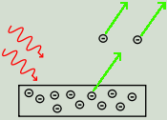
Image courtesy Wikimedia Commons
Notes:
And what einstein was doing there is what scientists have done throughout time: he wanted to explain the unexplained. With the wave nature of light, there was a phenomena that occurred that was a head scratcher for scientists. They didn’t understand why this was happening. That phenomena is called the photo exectric effect. Let me describe it to you: On the bottom there, you have a rectangle that represents a piece of metal. And inside that metal, you have the circles with minuses that are electrons. Electrons make up everything, and so the metal there has electrons. What the photoelectric effect is, is that when you bombard that metal with a high frequency of light, then electrons will be released off that metal. But, if you bombard that metal with a low frequency of light, electrons will never be released. And what was confusing about this, is that it didn’t matter what *intensity* the light was, only the frequency. If you hit that metal with a very small amount of high frequency light, then it would release electrons. But if you flooded that metal with as much low frequency light as is possible, the electrons would remain inside the metal. And this didn’t make sense because waves travel and transfer energy in a continuous manner. If what was releasing those electrons was an energy transfer from light to metal, then a high intensity of low freuency light should transfer enough energy to release those electrons, but it didn’t. And what einstein said, is that it looks like what is happening here is that the energy of light is contained in quantized packets of energy. Quantized… the quantum. Einstein said that the high frequency just had ibggere packets of energy while the low frequency had small packets of energy. He reasoned that the larger packets of energy were big enough to act like billiard balls knocking those electrons free. While the smaller packets of energy in the lower frequencies were so small they were acting like a feather trying to move a bowling ball, which is never going to happen. These quantized packets of energy were later named “photons”, and thus was born the particle nature of light. Now, einstien knew full well that young had proven, beyond doubt, that light is a wave, but einstein wasn’t the kind of guy to let existing knowledge stop him from discovering new truths.

Slide 26
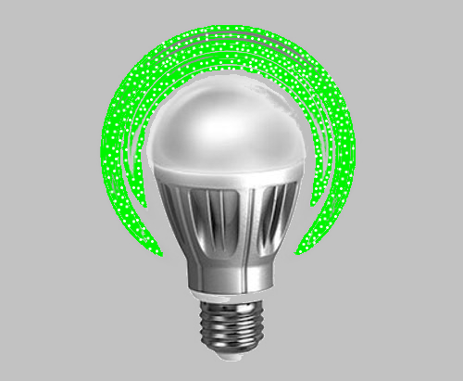
Notes:
Einstein said that in some cases light behaves like a wave and in other cases it behaves like a particle. And thus was born the wave-particle duality of light.

Slide 27
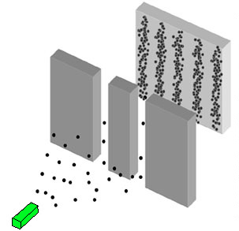
Notes:
But, that just created another enigma. What does it mean for something to be both a wave and particle? We’d never seen anything like that before and it just didn’t make much sense. So scientists then needed to poke and prod and figure it out. Now, this is a visualization of the double-slit experiment with photons. You can see the photons being emitted from the green block and creating the wave pattern on the back wall. You can easily imagine that a wave could go through both those slits. It would just hit the slit and diffract and create the wave pattern, so that makes sense. But, you’d also think that a particle, would only go through one of the slits. So, at first people thought that the photon was riding a wave. And they came up with the great idea to put an instrument on the other side of that wall to detect which of the slits the photon went through. Then if they looked at the wave pattern on the final screen and saw where all the left slit photons went, then maybe we could reveal something more about the wave-particle nature.

Slide 28
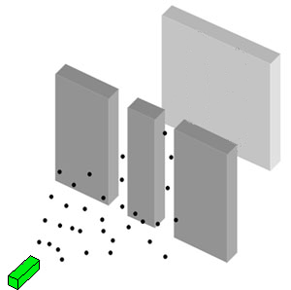

Notes:
So they did that, they put a measuring device on the other side of that wall to see which slit the photon went through, and it worked. But then something very strange happened that is still unexplained today. When they went to look at the wave pattern on the final screen to see where the photon ended up,

Slide 29
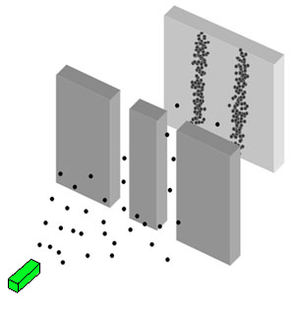
Notes:
A particle pattern appeared. Not a wave patterns.

Slide 30
Notes:
When they removed the measuring device detecting which slit the photon went through,

Slide 31
Notes:
The wave pattern reappeared.

Slide 32
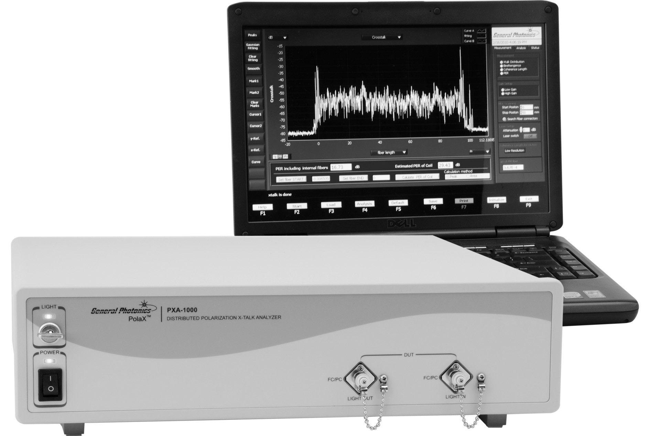
Notes:
As first they thought the measuring device was just getting in the way, but they ruled that out. Next, they thought there was some kind of physical interaction there, but they eventually ruled that out as well. And finally, the interpretation that bohr came up with (called teh copenhagen interpretation), is that this image is wrong. Bohr said that the particles are not actually traveling through space as a particle, but, rather, they are traveling through space as a wave of probability. That the particle could show up anywhere in that wave, but that it’s not actually there yet. He said that what caused the particle to appear, is when it’s measured. The act of measuring is what collapses the wave of probability down to a photon of certainty. At first, einstein had a big problem with this this is where he quote about god playing with dice comes from. He didn’t like a non-deterministic universe. He wanted to believe that if we knew the initial state of all particles, then we would be able to make perfect predictions about what would happen, but the copenhagen interpretation says that it’s just a random chance as to where that particle will show up. Einstien eventually came to terms with the non-deterministic nature of the interpretation, but what he never came to terms with and what he fought neils bohr about the rest of his life, was an observer-dependant reality. When bohr said that the act of observation transformed the wave of probability to a particle of certainty, this meant that these particles wouldn’t exist without an observation. Einstein was very uncomfortable with this, and you could easily imagine why. We are now starting to get into the realm of philosophy and meta-physics and away from the realm of science. For example, one of the first question you have to ask when bohr says that observation creates the reality, is “what does observation mean? What constitutes an observation?” Now, almost every gets to a point where they settle on some point of explanation that works for them, and then they move on. Often, that means that they just accept that someone else has figured it out and then they can go back to living life. But the reality is, that they haven’t really resolved much of anything. The more they dig into it, the stranger it gets. Let me give you an example. When asking the question about “what does observation mean?”, one of the natural questions to ask is “does it need to be a conscious observer?” a very simple experiment seems to answer the conscious question in a firm “no.” Imagine, if instead of these eyes, which convey a conscious observer, you had a dumb instrument that is doing the measuring and recording. Then let’s say you setup that dumb instrument and then set the photon emitter to push out a photon once every half a second. Next, we walk away and have lunch, catch a movie, waste some time. When we come back, we can see the particle pattern and see the results of the measuring device, and notice that the unconscious instrument was able to cause the wave collapse to particle, so we don’t need a conscious observer. But, the more experiments we run, the stranger things seem to get.

Slide 33
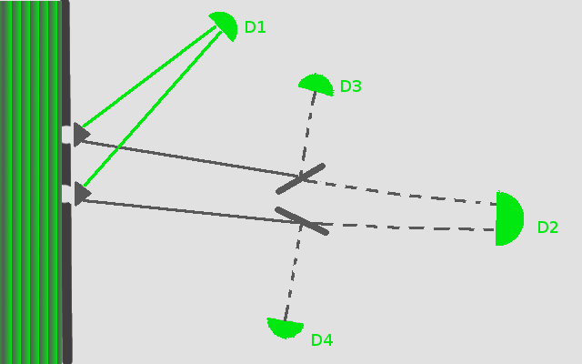
A
B
Notes:
In 1999, a team of experimenters out of the university of maryland led by Yoon-ho Kim performed this experiment that was thought up by Marlan O. Scully out of Texas A&M. it’s called the “delayed-choice quantum eraser double-slit experiment” It’s a highly modified double-slit experiment. Over on the left, where the green and grey lines are, that’s a wave of light. The light travels right until it hits the slits and A and B. right beyond the slits, the triangles are crystals that will split a photon into two different photons. The upper track photon is directed to resolve at Destination 1. The lower track photons will resolve at D2,D3, or D4. Now, there are two things i want you to notice that happens at D1. when the upper track photon gets resolved there, notice that we are also sending photons from B there as well. You cannot tell which of the slits the D1 photons came from. And what you see there at D1 is the expected wave pattern. The other thing to note here, is that the upper track photon gets resolved at D1 before the lower track photons get resolved. Ok, then we move forward with the lower track photon until we hit this point which is a half-mirror all that means is that the photon has a 50% chance of being reflected to D3 and a 50% chance that it will pass through and go to D2. Now, notice from this diagram, that at D3, you know which slit it went through. The only way to get to D3, is to have come from slit A. similarly, the only way to get to D4 is to have come from slit B. and what we see at these locations, are particle patterns. There is no wave interference here. Now, D2 is like D1 in that we are sending photons from both A and B there, and what we see is an interference/wave pattern there, all as expected. So, D2 and D1 have wave patterns while D3 and D4 have particle patterns. But, with this setup, we can then fool mother nature and finally see what slit a photon goes through but still see it in it’s wave pattern. So, remember that when the upper track photon hits D1, it’s creating a wave pattern. All we have to do, is record the time there. Then, when we move forward and hit D3, then we can record the time there. Now, with the times recorded, all we have to do is look at the times that photons have hit D3 and then find the correlated particles at D1 that hit 9 nanseconds before the particles at D3. at this point, we know that those particles at D1 that are correlated with D3 all went through A, but they produced the wave/interference pattern. So, we are going to fool mother nature! Unfortunately, mother nature is not so easily fooled because when you isolate the particles at D1 that are correlated with the particles at D3, you actually don’t see the interference pattern. Instead, you see a particle pattern. When you isolate the particles at D1 that are correlated with the particles at D2, you see the interference pattern. This is just plain strange, because remember, the particle at D1 was resolved 9 ns before the paired particle would be resolved at D3 or D2. it’s lmost as if the particle at D1 is looking ahead in time to know whether we are going to be able to tell which slit it went through. Now, it’s been proven that the particle at D1 is not looking ahead, but the current best explanation is that the particles at D3 and D2 are causing the effect at D1. the term is called “retrocausality” and it’s just baffling. It’s problematic to us because we live our lives counting on cause preceding effect. But in this case, we are saying it might be possible that effect is happening before cause. So troubling philosophically.

Slide 34
science cannot solve the ultimate mystery of nature. and that is because, in the last analysis, we ourselves are a part of the mystery that we are trying to solve
Max Planck
Notes:
And this is why plank made his fatalistic statement about the ability of science to be able to get to the ultimate mystery of the universe. Remember, he said that we cannot get to it because we ourselves are part of the mystery. Basically, we are trying to determine if our observation collapses reality, yet the scientific method requires observation. And this is showing us that even time-displaced observation may very well have an impact on the prior outcome. We cannot come up with an experiment where we observe our non-observation in order to truly test this, so it’s an oxymoron that seems to have us kind of stuck. If the copenhagen interpretation is correct.

Slide 35
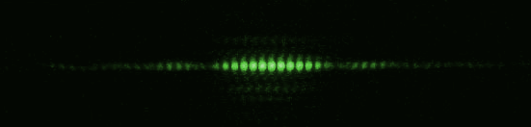
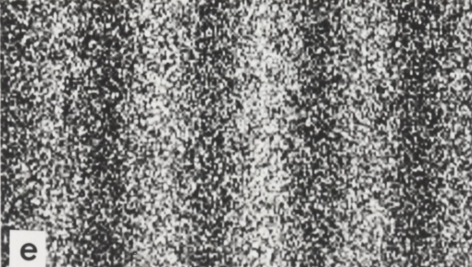
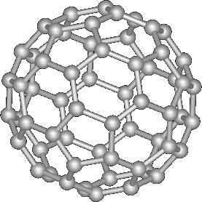
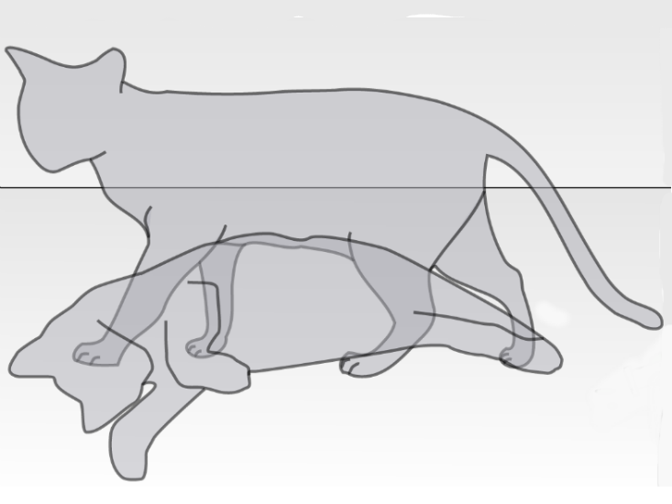
Notes:
Now, if you are like me, when i first heard about einsteins particle nature of light, i thought it was a bit of a stretch. Just because light behaves like a particle doesn’t mean that it is a particle. There are plenty of things that act like what they aren’t. One thing that had me hung up, is that , in my mind, for something to be a particel, it would need mass. And light/photons do not have mass. But, it really doesn’t matter. This is an example of the double slit experiment with a green laser, so we know that light has this wave-prticle duality. This, is the results of an experiment done ny Hitachi with electrons. It’s a double-slit experiment that has produced a wave pattern. Electrons have mass, so that means that electron travel as a wave of probability only to collapse to an electron of certainy once observed. And they have done the double-slit experiment with increasingly more and more complex molecules. This is a bucky-bal. It’s 60 carbon atoms arranged in a very specifica structure. They have done the double-slit experiment with bucky-balls and have seen wave inerference. That means that bucky-balls travel as a wave of probability only to collapse to a bucky-ball of certainty once observed. And when we are talking about molecules, there is no reason to believe that this wouldn’t scale up to include everything. That everything exists as a wave of probility only to collapse to a thing of certainty once observed. And when i say everything, i’m also talking about possibly the life of shrodinger’s cat. You’ve probably heard refernce to this as it’s al over popular culture. You may have heard reference to the cat being both alive and dead until observed. To summarize in case you havent heard it, you have a diabolical device in a box that has a 50% chance of releaing a gas. You then put a cat into the box and seal that box up from our world. That no information would be able to get into the box or out of the box. We don’t really know how to do this, but it’s a thought experiment, so we could imagine it. The point is, under the copenhagen interpretation, that if we did have such a box, then, yes, the cat would exist as a wave of live and dead probability until we open the box to observer. Now that assumes that the cat itself is not able to be it’s own observer. Wht’s interesting about this thought experiment, is that schrodinger came up with the experiment to illustrate how absurd the copenhagen interpretaiton was. He sided with einstein in not believing in an observer-dependant reality. So he came up with this thought experiment to show people how absurd they were being. And, honestly, he was right. To our view it is absurd, but it doesn’t mean it’s not right. It was this observer-dependant reality that caused plank to be so fatalistic in his view about science not being able to resolve the ultimate mystery of nature. If you think about it, we are saying that observation creates reality, but observation is a fundamental requirement for the scientific method. Since our experimental observation, even if it’s delayed, might very well be what is causing the collapse, we can’t study the theory without disturbing it. We cannot observe our non-observation, so we are kinda stuck here. Now, if you are one who is foundationally disturbed by the idea of an observer-dependant reality, like einstien and schrodinger, then you are in good company. You also share that belief with this guy:

Slide 36
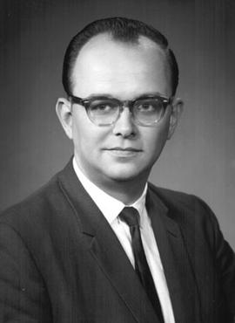
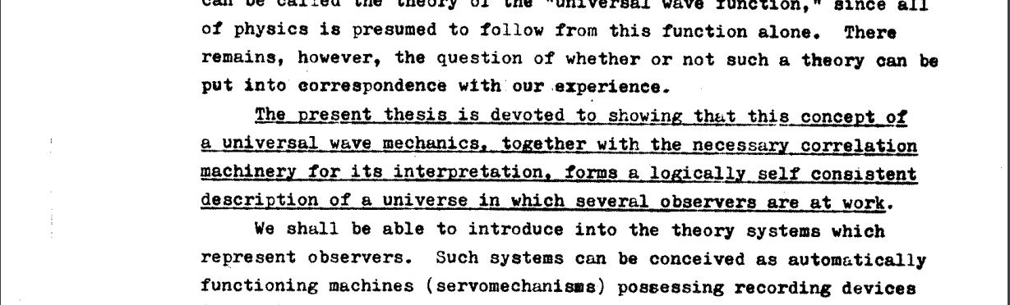
1956
Relative-State Formulation
Many-worlds Interpretation
Notes:
His name is hugh everett iii. In 1956 he was a physics phd candidate out of princeton. He did not like the idea of an observer-dependant reality, so he decided he was going to come up with an alternate interpretation to what was going on that would get rid of the need for an observer. The paper he wrote was his phd thesis and he named the idea the “relative state formulation”, but it was later redubbed as the “many-worlds interpretation”

Slide 37
Notes:
Basically, what he said there is that this visualization, that i told you earlier was wrong under the copenhagen interpretation, is actually right. He’s basically saying that in everyy place that that particle COULD be, it actually IS there. And it’s not there in some kind of smeared abstract probablity concept, but that it is actually there in every place asmuch as you and i are here right now. Of course, there are some problems with that idea. The first thing you should point out to everett is to say “that’s crazy man. We only see it in one place when we measure it, so stop talking nonsense”, but his response would be “ah, yes, but that’s because every place that the particle could be, it IS actually there, but in a separate universe. That every possible probability for those particles creates a completely separate universe that has that particle in that location. And there’s a copy of you over there looking at the location of the particle and wondering why it’s not showing up over here if my theory is right.” And that’s the essence of the many worlds. Now, if you think about it, if we were able to travel to a parallel universe where the only difference is the positioning of a single photon, then we would not see any kind of difference between that universe and our own. Except for the fact that there’d be a twin of you that would probably be a bit irritated. But, think about how many photons there are in just this one simple experiment. And think about all the different permutations and combinations of location that you would have to create in order to take care of every contingency. What if you were in the universe where all the photons in this experiment ended up only on the left thus not illuminating the wall to the right. Now, what if there were universes where you were the random illumination of the light particles caused you to miss an important visual cue, so you never asked that significant other out.

Slide 38
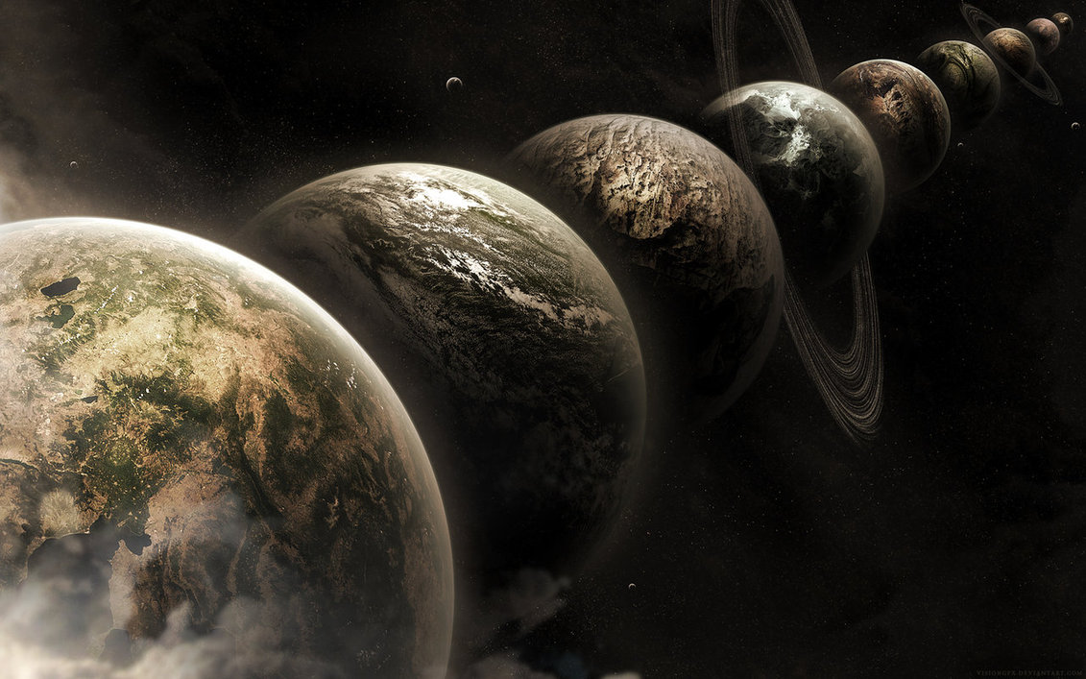
https://www.flickr.com/photos/chingster23/11937781733/
Notes:
Now, realize that when it’s everything in existence in their probablistic wave form interacting with everything else, you can imagine that there would be an almost infinite number of universes being created for all these different combinations. What’s also intereesting ot me, is that everett’s theory was not taken seriously when he published it. Noone really looked much into it and he never got a job in academia. He worked for the state department. But, later on in his life, more and more people started to look at it as a serious alternative to the copenhagen interpretation. And today, it seems to be catching on even more and more.

Slide 39
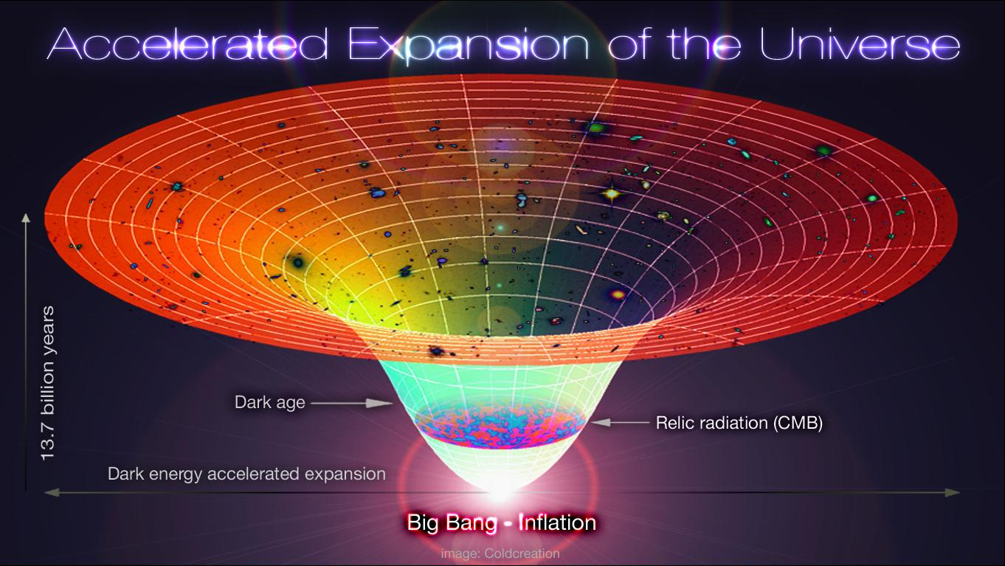
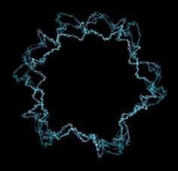
Notes:
I think oneof the reasons it’s starting to gain in popularity, is because ther are other branches of physics that posit the existence of parallel universe to explain other things in their discipline. For example, in cosmoology, there is the idea that our universe is inflating eternally. That it will continue to inflate forever. Every model that is used to show eternal inflation has to incorporate elements of an dinfinite unumber of “bubble universes”. The term in this branch of cosmology is called the “multiverse”. S a different branch of physics invoking the idea of parallel universes to describing different phenomena. Also, the math of string theory predicts mutliepl universes as well. I think that all these ideas are causing us to seriously look at parallel universes and alternate realities as a very real possiblity.

Slide 40
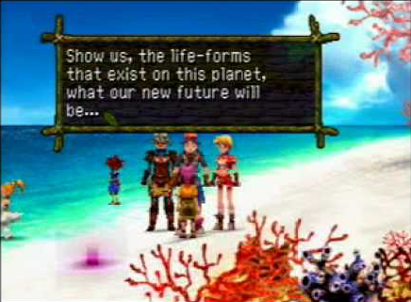
Notes:
Now, i said ti before, but there is no proposed concept on how to create a portal to these other universes. But imagine if you could do so, we might be abel to visit drastically different world, or live drastically different lives, and even meet drastically different versions of ourselves. But as i wrapped this presentation up, i realized that we really don’t have to wait until we create these portals to these other places. In a sense, we are visiting them now in our imagination in every medium that we tell stories in. and especially, in our games where we become active participants and as virtual reality approaches full immersion, we will be exploring these places anyway even if the science isn’t accurate.

Slide 41
brian kirkby ( bkirkby@kirkby.org )
http://bkirkby.github.io/
@therealpheirce
questions?
special thanks to:
patrick gradie
dale anderson
brian anderson

Slide 42
references
Quantum: Einstein, Bohr, and the Great Debate about the Nature of Reality, Manjit Kumar, ISBN-13: 978-0393339888
The Original Double Slit Experiment, Veritasium, https://www.youtube.com/watch?v=Iuv6hY6zsd0
Quantum Mechanics for Scientists and Engineers, David Miller, https://lagunita.stanford.edu/courses/Engineering/QMSE01./Autumn2015/about
Delayed-choice Quantum Eraser, Wikipedia, https://en.wikipedia.org/wiki/Delayed_choice_quantum_eraser
Quantum Eraser/Delayed Choice Experiment, Hythloday71, https://www.youtube.com/watch?v=KnpCH9VRvPg
Many-worlds Interpretation, Wikipedia, https://en.wikipedia.org/wiki/Many-worlds_interpretation
Parallel Worlds, Parallel Lives, EELS, https://vimeo.com/58603054
Hugh Everett III, Wikipedia, https://en.wikipedia.org/wiki/Hugh_Everett_III
Newton vs. Huygens, Christian-Albrechts-Universität zu Kiel, http://www.tf.uni-kiel.de/
Eternal Inflation, Wikipedia, https://en.wikipedia.org/wiki/Eternal_inflation
Photoelectric effect, Wikipedia, https://en.wikipedia.org/wiki/Photoelectric_effect
Wave-particle duality, Wikipedia, https://en.wikipedia.org/wiki/Wave%E2%80%93particle_duality

